Slide 1

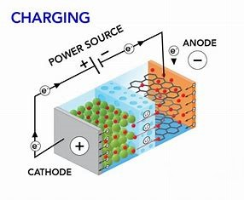

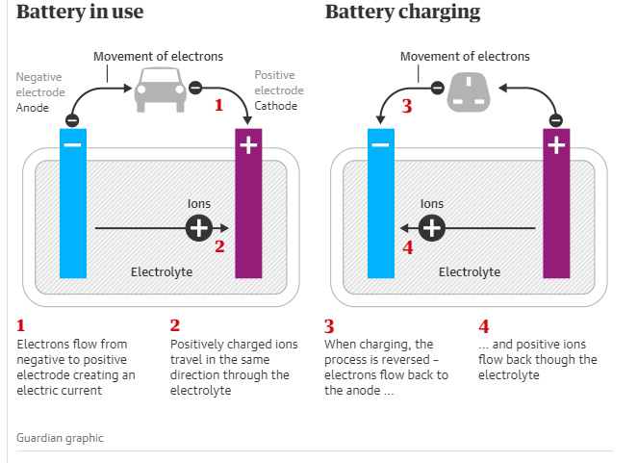
INTRODUCTION
Battery charging converts electrical energy into chemical energy, powering essential devices and systems.
PRINCIPLE
Battery charging is based on the principle of restoring the charge in a battery by supplying it with an external electrical source, converting electrical energy into chemical energy.
BATTERY CHARGING
NAME :E.G.Pradeep
Roll no:RA2211004050026
POWER RATING
Small Devices(5W-15W)
Large Devices(50W-200W)
Industrial Applications(Several KW)
MERITS
Modern chargers are highly efficient, reducing energy waste.
DEMERITS
Excessive heat during charging can reduce battery life.
APPLICATIONS
Consumer Electronics:Smartphones,Laptops
Electric Vehicles:EV Charges for cars,bikes
Renewable Energy Sytems:Charging batteries from solar or wind
OUTCOME OF THE ACTIVITY
Understanding the working principles of battery chargers.Ability to identify and explain the key components of a charger.Awareness of the practical applications and importance of efficient battery charging in various fields.

